Slide 1
Melanoma skin cancer classification

Slide 2
Content
Main objective
Dataset Description
Data Exploration & Preprocessing
Model Training Variations
Recommended Model
Key Findings
Next step

Slide 3
Main objective
The primary objective is to develop a deep learning model to classify skin lesions as benign or malignant from clinical images.
This binary classification task employs convolutional neural networks a subset of deep learning optimized for image analysis.
The model aims to assist dermatologists in early and accurate diagnosis, reducing unnecessary biopsies and improving patient outcomes

Slide 4
Dataset Description
The dataset have 9605 training images (5000 benign, 4605 malignant) and 1000 test images (500 per class).
Key attributes:
Image size: 224x224 pixels
Channels: RGB
Classes: Binary (Benign vs Malignant)

Slide 5
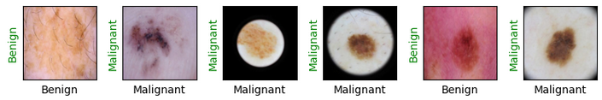
Data Exploration & Preprocessing
Class Balance: Moderate imbalance addressed via random sampling during training.
Transforms:
Resize to 224x224.
Random horizontal flipping for augmentation.
Normalization using ImageNet statistics.
Dataset Splitting: 30 images per class moved to test set for validation

Slide 6
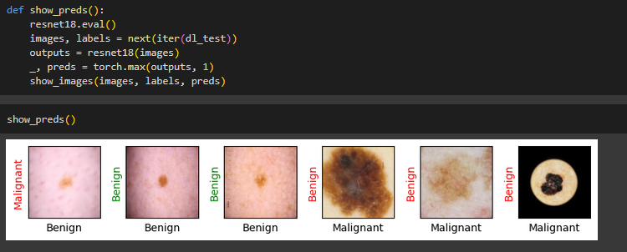
Model Training Variations
Baseline CNN: Simple architecture (3 convolutional layers, 2 fully connected layers).
Hyperparameters: LR=0.001, batch_size=6.
Accuracy: 85% on test set.

Slide 7
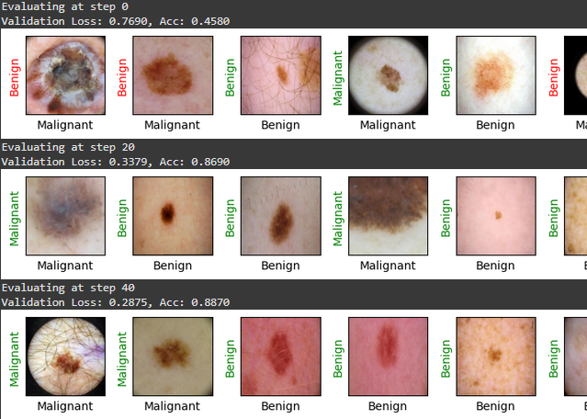
Model Training Variations
Transfer Learning (ResNet-18): Pretrained on ImageNet, fine-tuned.
Hyperparameters: LR=0.0001, batch_size=6.
Accuracy: 93% on test set.

Slide 8
Recommended Model
The Modified ResNet-18 with regularization is recommended for its balance of accuracy of 93% and robustness. While marginally more complex than the baseline, its use of pretrained weights and dropout layers enhances generalizability making it suitable for clinical deployment. Explainability can be achieved Grad-CAM visualizations to highlight lesion regions influencing predictions.

Slide 9
Key Findings
Transfer learning (ResNet-18) outperformed custom CNNs by 7-8% accuracy.
Class imbalance minimally impacted performance due to random sampling.
Data augmentation improved model generalizability.
Malignant cases showed slightly higher misclassification rates, likely due to subtle visual features

Slide 10
Next Step
Expand Dataset: Include more diverse images across skin tones and lesion stages.
Test Advanced Architectures: Evaluate EfficientNet or Vision Transformers.
Clinical Integration: Develop an API for real-time dermatologist assistance.
Explainability Audit: Validate Grad-CAM results with medical experts to ensure alignment with clinical markers

Slide 11
Thank you
Akitha Pasandul

